Slide 1
Data Analysis - Exploring the Relationship Between Modes of Transportation and Median Income in the Tri-Cities
By: Matt Luong

Slide 2

Research Question:
What influence does median income have on commuting behaviours in the Tri-cities area? Are there any patterns that can help us understand this relationship?

Slide 3
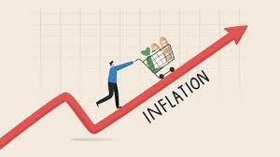


Our Motivation
Navigating the Cost of Living: Allocation of Financial Resources.
Highlighting the crucial relationship between income and mode of transportation helps urban landscapes and planning.
Helps identify the barriers to mobility that affect our daily lives and activities.

Slide 4
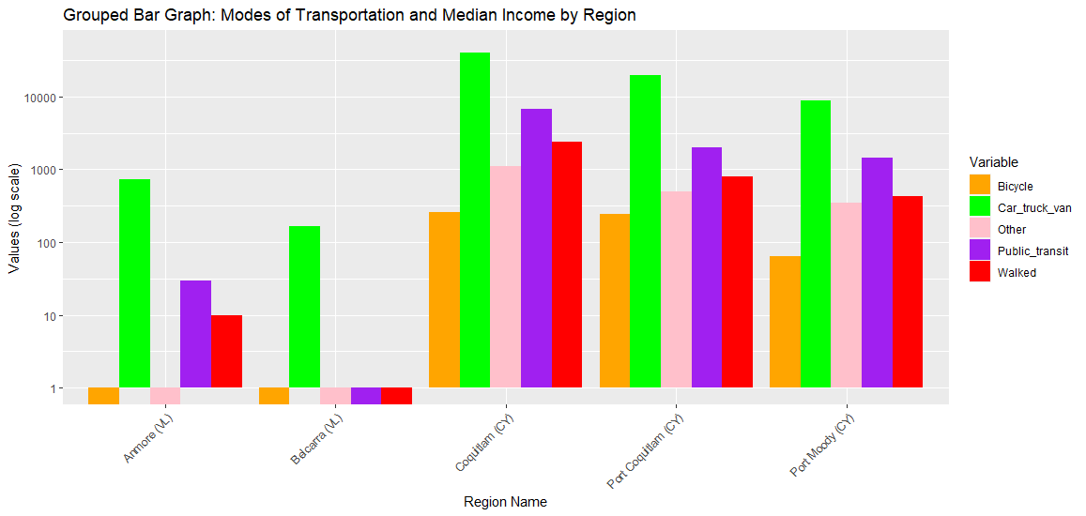
Visualization 1

Slide 5
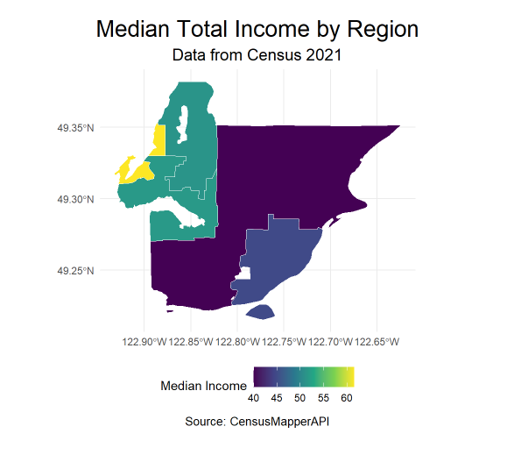
Visualization 2
Belcarra
Anmore
Coquitlam
Port Moody
Port
Coquitlam

Slide 6
Conclusion
High reliance of personal vehicles in the Tri-cities area.
There is availability of alternative modes of transportation options in the more populated areas such as Port Coquitlam and Coquitlam.
Villages in the Tri-cities such as Anmore and Belcarra drive more with higher income and lower accessibility to public transportation.

